Slide 1

Notes:
Around for 100 years
Previous part of Delphi

Slide 2
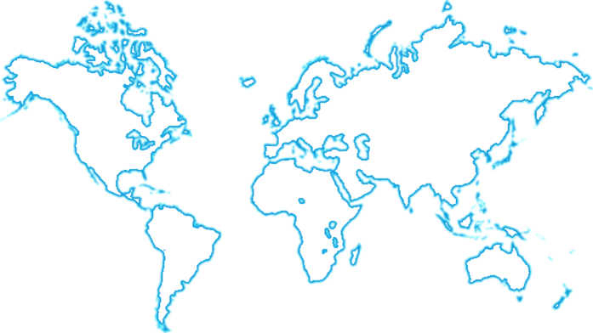
North America
Technical Centers
Juarez, Mexico
R&D Centers
Agoura Hills, CA
Troy, MI
Kokomo, IN
Juarez, Mexico
Manufacturing Facilities
Reynosa, Mexico
Matamoros, Mexico
Asia Pacific
Technical Centers
Shanghai, China
Bangalore, India
R&D Centers
Suzhou, China
Atsugi, Japan
Auckland, New Zealand
Seoul, South Korea
Manufacturing Facilities
Suzhou, China
Chennai, India
Ang Mo Kio, Singapore
European
Headquarters
Wuppertal, Germany
North American
Headquarters
Troy, MI
Asia/Pacific
Headquarters
Shanghai, China
United States
Kokomo, IN (HQ)
Europe
Technical Centers
Krakow, Poland
R&D Centers
Paris, France
Hildesheim, Germany
Munich, Germany
Nuremberg, Germany
Wiehl-Bomig, Germany
Wuppertal, Germany
Turin, Italy
Gothenburg, Sweden
Manufacturing Facilities
Osberghausen, Germany
Szombathely, Hungary
Skopje, Macedonia
Gdansk, Poland
Braga, Portugal
ARIoT | March 2019 | David Johansson
Notes:
6000 engineers
40 biljons lines of code

Slide 3
Safety
Electronics
Autonomous
Driving
Infotainment
User
Experience
Connectivity
& Security
ARIoT | March 2019 | David Johansson
Notes:
Safety Electronics – Radars and other sensors
Autonomous Driving
Infotainment – Information and Entertainment
User Experience – Multi Layer Displays
Connectivity and Security

Slide 4
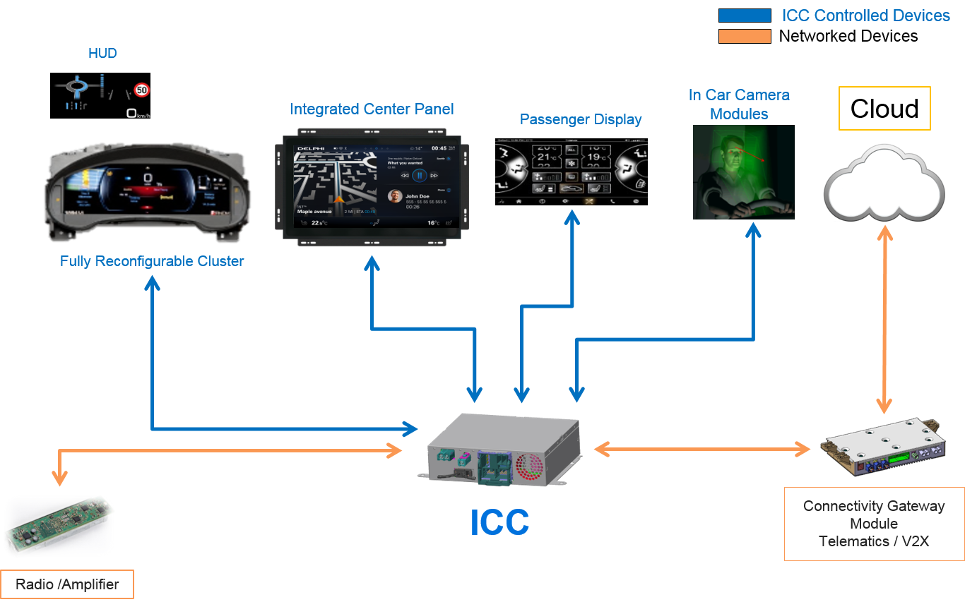
ARIoT | March 2019 | David Johansson
Notes:
Our Integrated Cockpit Controller is the industry's first and improves graphics by a factor of 10 and reduces mass by more than 30 percent. It also has five times improved computational speeds vs. the current systems, enabling an advanced user experience. And this Ferrari is on the road today!

Slide 5

ARIoT | March 2019 | David Johansson

Slide 6

Quesadilla
Quiche
Quinoa
Quail
Quesito
Qurabiya
Quaker Oats
Quenelle
Quinoa Pudding
ARIoT | March 2019 | David Johansson

Slide 7

Audio
Appstore
HVAC
Maps
Rear view
camera
Assistant
Power
ARIoT | March 2019 | David Johansson

Slide 8

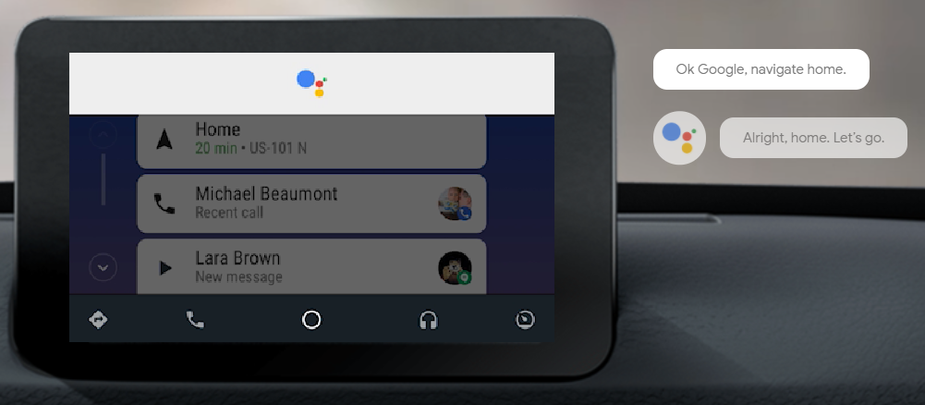
Extending the Ecosystems of the ”Giants”
ARIoT | March 2019 | David Johansson

Slide 9

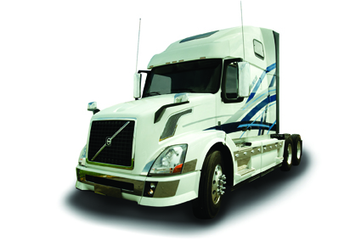
Think of us next time you buy ...
ARIoT | March 2019 | David Johansson

